Slide 1
3D Printing
National Summer Steamup 2017

Slide 2
Types of 3D additive printer
BJ – Binder Jetting (Powder/Resin)
DLP – Digital light processing (Photoset Resin)
EBM – Electron Beam Melting (Metal Powder)
FDM – Fused Deposition Modeling (PLA, ABS…)
LOM – Laminated Object Manufacturing (Paper)
MJ – Material Jetting / Wax casting (Wax, Food)
SLA – Stereo lithography (Photoset Resin)
SLM – Selective Laser Melting (Plastic / Metal)
SLS – Selective Laser Sintering (Metal)
https://all3dp.com/types-of-3d-printer-technology-explained/

Slide 3
Most common FDM
Most consumer 3D printers are Fused Deposition Modeling
Extruded plastic.
ABS Acrylonitrile Butadiene Styrene (Like plastic models)
PLA Polylactic Acid (Biodegradable)
PVA Polyvinyl Alcohol (Water soluble) for support
PET PolyEthylene Terephthalate
Wood
Metal
Many more…
https://www.allthat3d.com/3d-printer-filament/

Slide 4
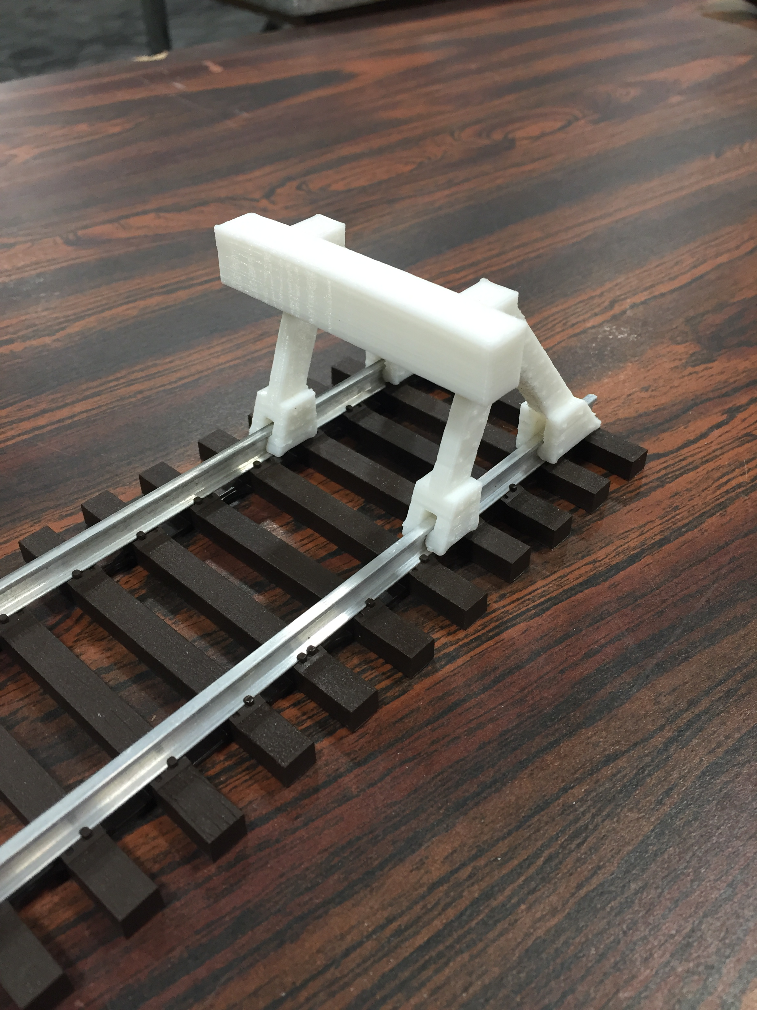

Slide 5
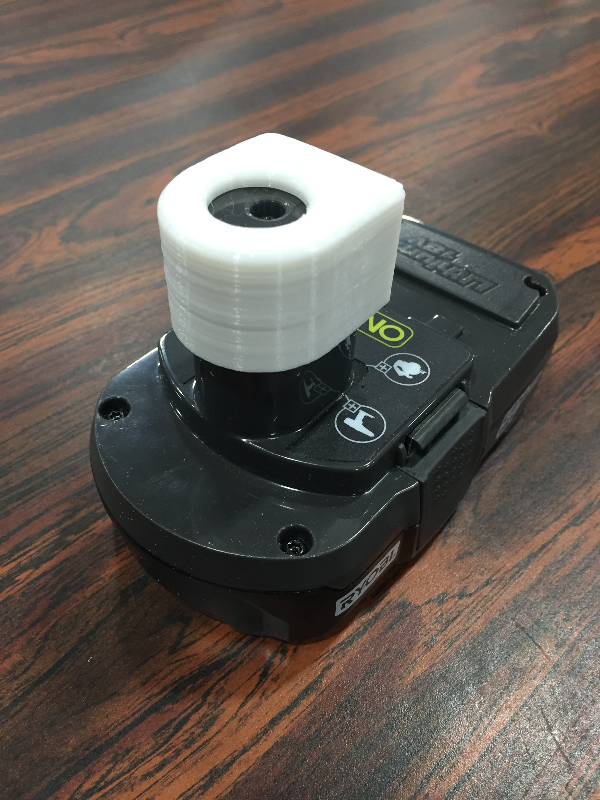

Slide 6
FDM Printers
Available to the hobbyist…
Makerbot -- https://www.makerbot.com
BoxZY (Also CNC & Laser) -- https://boxzy.com
$$$
Dremel -- https://3dprinter.dremel.com
$$
Ultimaker -- https://ultimaker.com
$
Many more…

Slide 7
SLA / DLP Photoset Resin
Professional but beginning to be available to the hobbyists.
Formlabs -- https://formlabs.com
$$
ONO -- https://www.ono3d.net
$
Uses your cell phone and in the future tablet.
Many more…

Slide 8
EBM / SLS Metal Printers

Slide 9
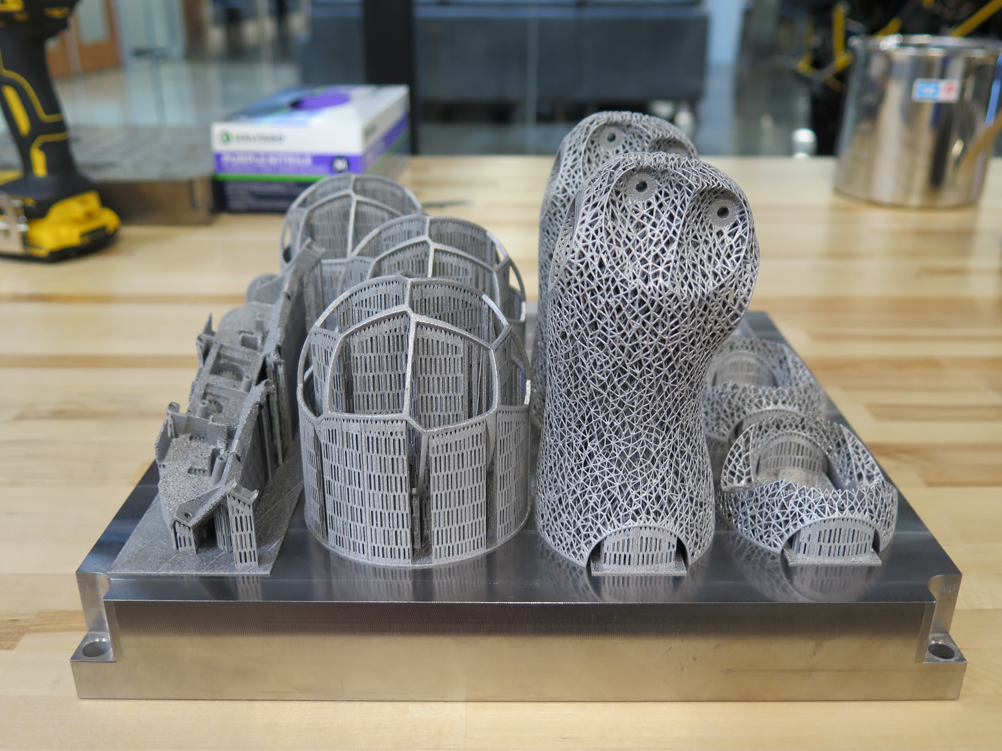
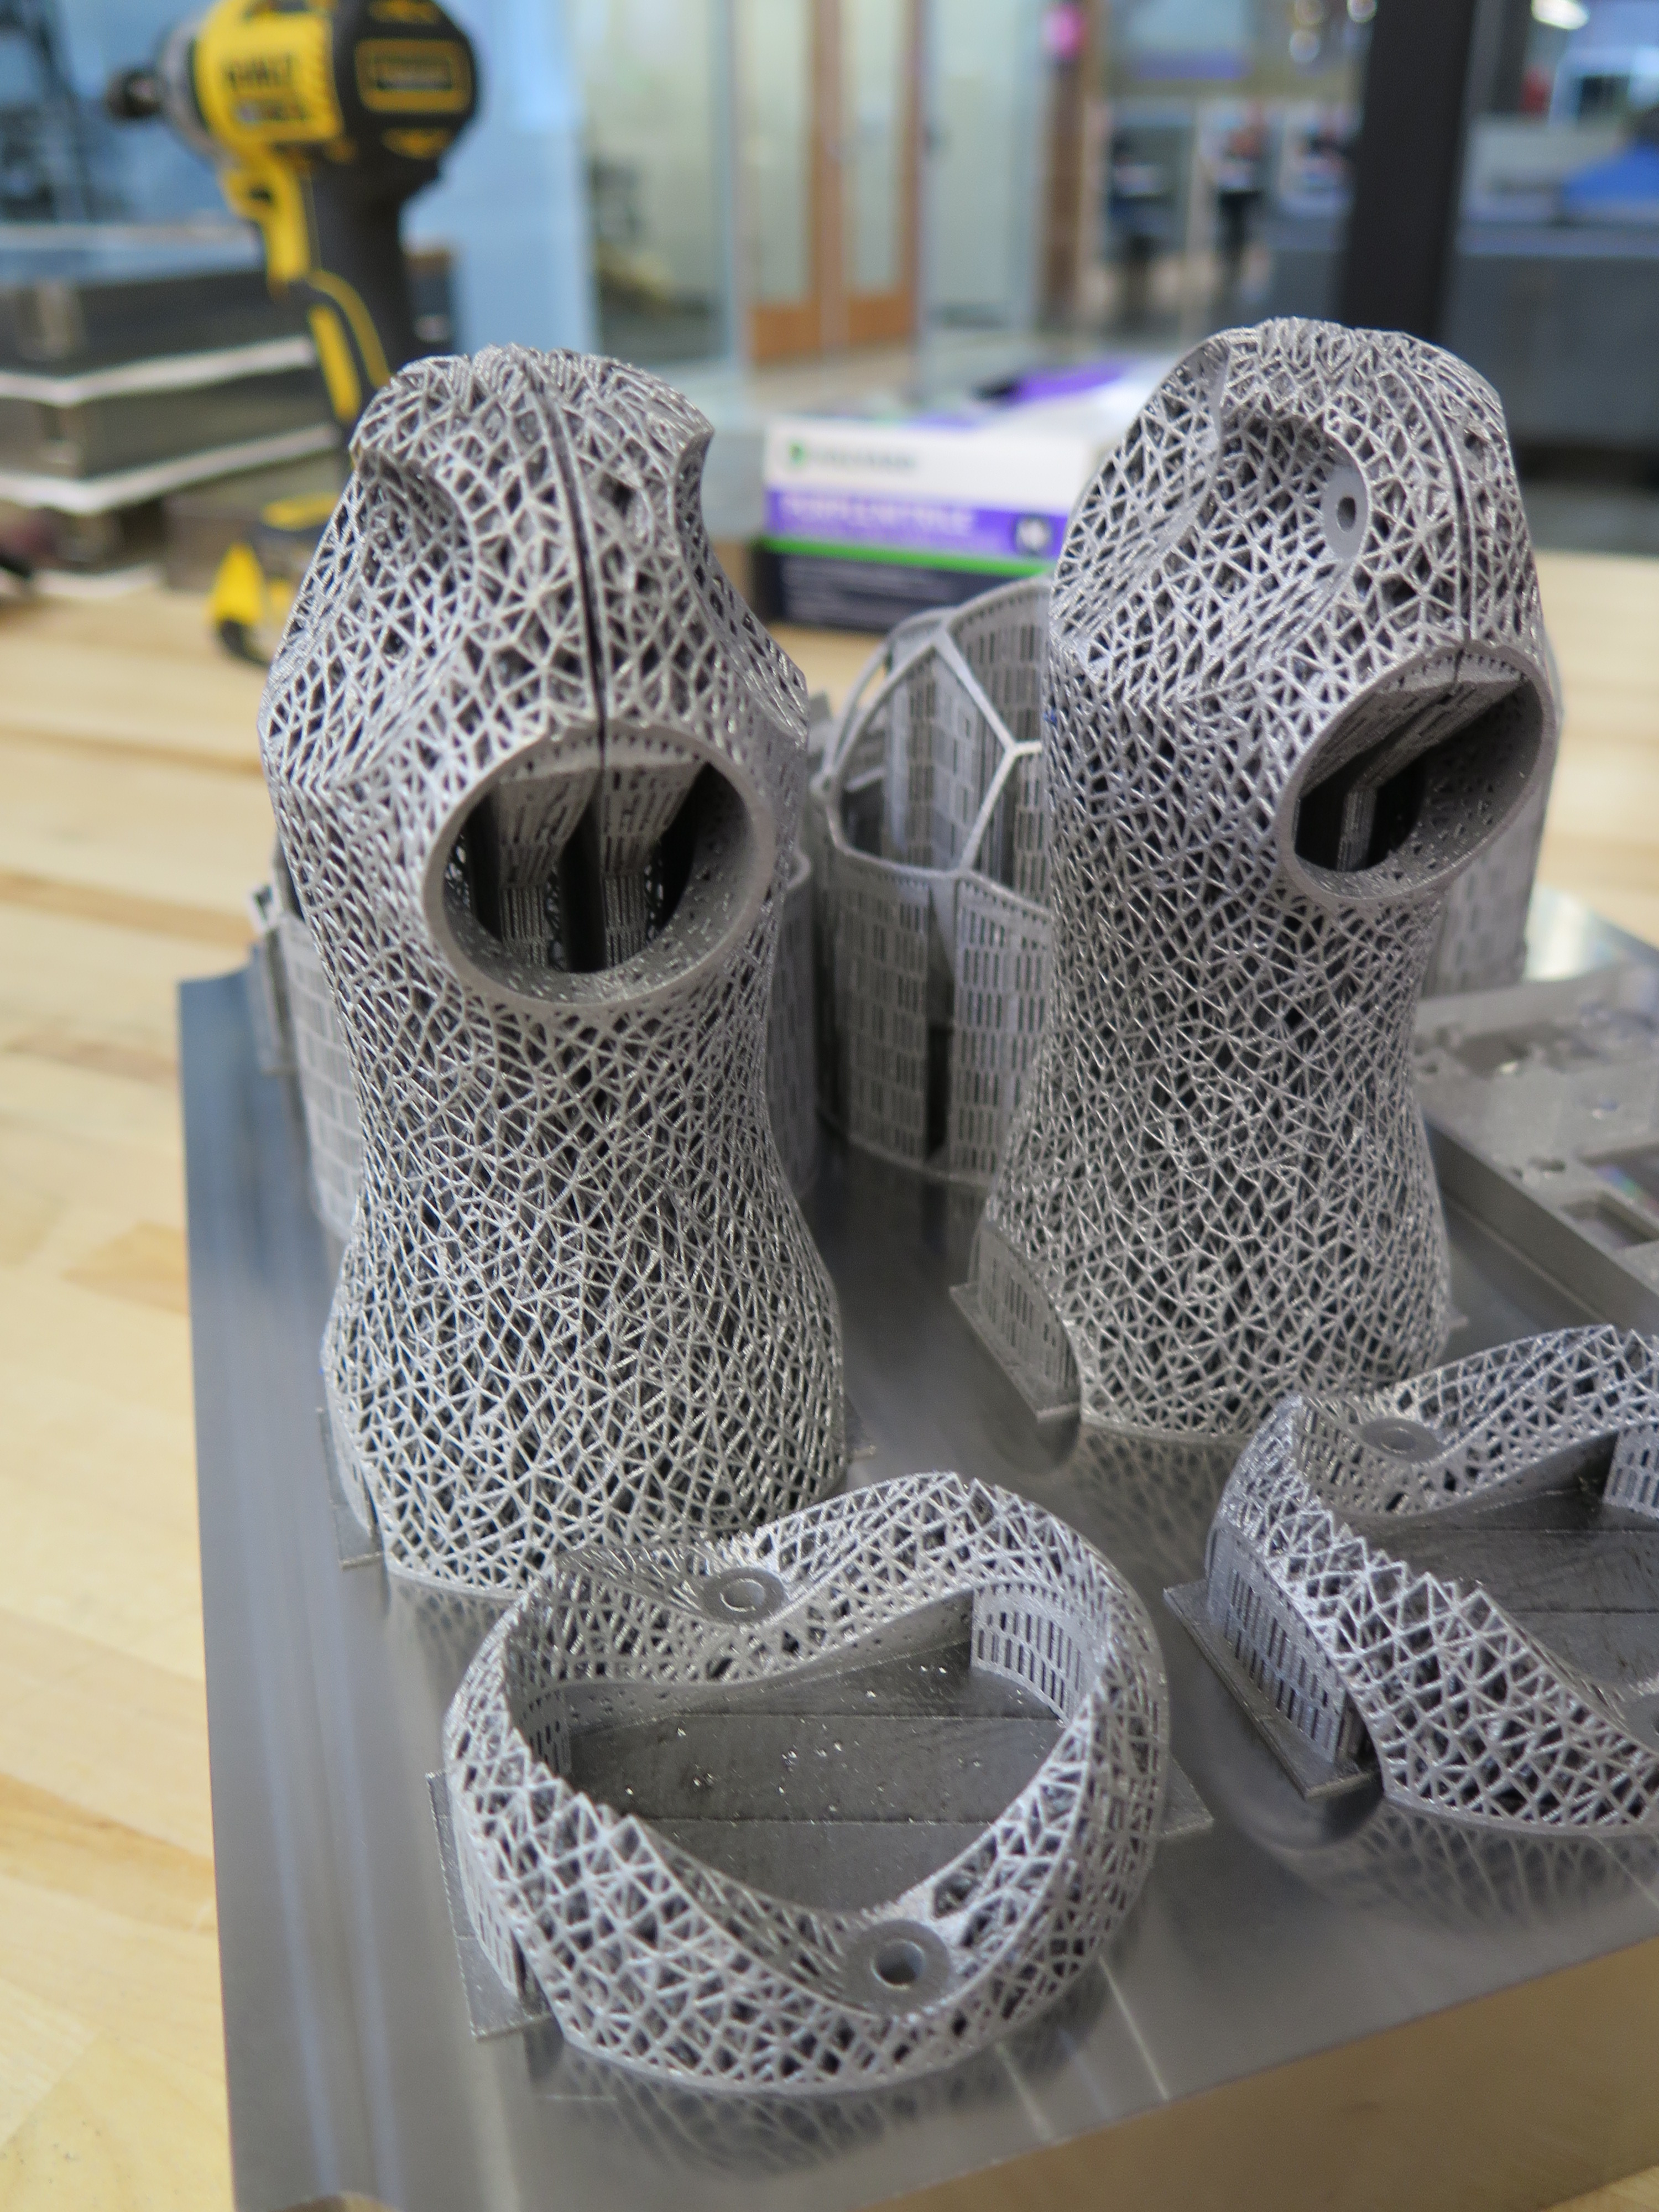
EBM / SLS Metal samples
$$$$$

Slide 10
Software
Model creation
Solidworks (Professional Windows $$$)
Autodesk Fusion 360 (Free version for hobbyists)
http://OnShape.com (Web based)
Shapr3D (iPad Pro)
Slicing
Slic3r
https://all3dp.com/1/best-3d-slicer-software-3d-printer/

Slide 11
Downloading Models to Print
Thingverse
GrabCAD
https://all3dp.com/1/free-stl-files-3d-printer-models-3d-print-files-stl-download/

